Slide 1


PREPARING THE COVER LETTER, CURRICULUM VITAE,ONLINE INTERVIEWS AND PHYSICAL AND VIRTUAL MEETINGS ETIQUETTE
Presented by:
Group 5

Slide 2


What is a
Cover Letter?
A cover letter is a formal document that accompanies your resume or curriculum vitae (CV) when applying for a job. It serves as a personalized introduction to your application and provides an opportunity to highlight why you're a strong candidate for the position.

Slide 3
The Purpose of Cover Letter
Personalizes Your Application: It allows you to address the employer directly, giving a personal touch that a resume can’t.
Shows You’ve Done Your Research: A good cover letter demonstrates that you've taken the time to research the company and understand its culture, mission, and values. This shows the employer you're not just sending out generic applications, but that you genuinely want to work for them.
Highlights Relevant Skills: It gives you the chance to match your qualifications and skills directly to the requirements of the job, proving that you are a strong candidate.
Gives You an Opportunity to Stand Out: While your resume gives the facts, your cover letter allows you to tell the story behind those facts—why you’re passionate about this job, why you want to work for this company, and why you’d be a valuable addition to their team.

Slide 4
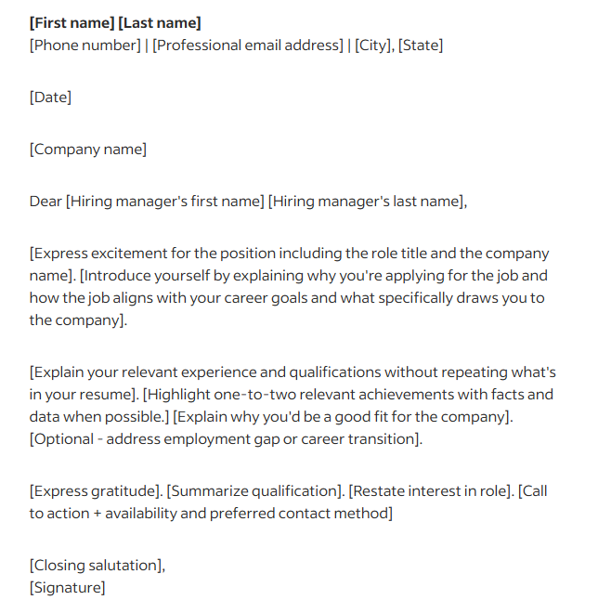

3 main parts of
Cover Letter
Intro - Who you are, what position you're applying for, and why you're interested in the job.
Body - 1-2 paragraphs describing your qualifications, skills, and experience relevant to the job.
Conclusion: A polite closing statement that expresses your enthusiasm for the opportunity and thanks the reader for their time.

Slide 5

What is Curriculum Vitae?
A curriculum vitae (CV), Latin for “course of life,” is a detailed professional document highlighting one’s education, experience and accomplishments. It defines what kind of applicant you are for the job. It determines if you are the right person for the job.
As one of the essential requirements for job hiring, your CV should demonstrate to any prospective employer why they should hire you above any of the other skilled candidates who have presented themselves for employment.

Slide 6


Basic Rules of Curriculum Vitae Writing
Write with the recruiter or human resource manager in mind. Assume that you are the recruiter. Think about what he needs to know about you. Consider the job description.
Present your CV to inform them well about what they need to know. Show it in a way that it reveals very professional and credible information.
A well-written CV limits the chance of not selecting you. It easily puts you in the shortlist.
CV the most important documents needed in job screening. They provide the highlights of your qualifications, work experiences, competence, professional and educational history.
In some academic institutions, the CV or resumé is the standard for job applications. The objective of both CV and resumé remain. However, the appearance of the document is noticeably different.

Slide 7
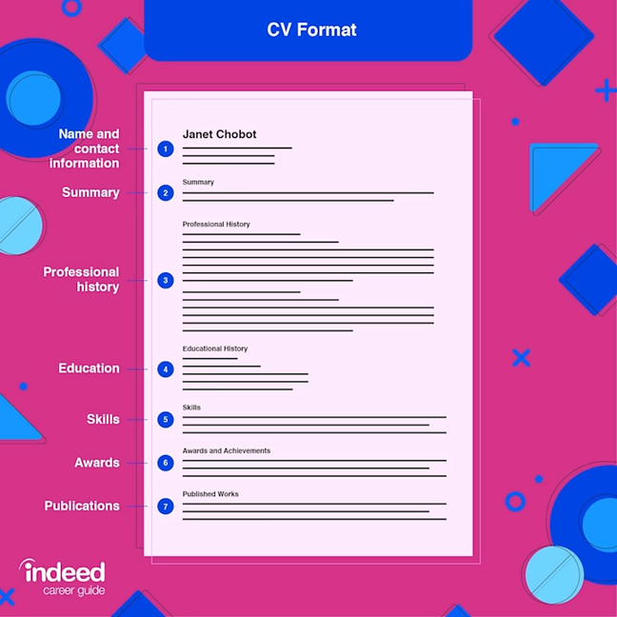
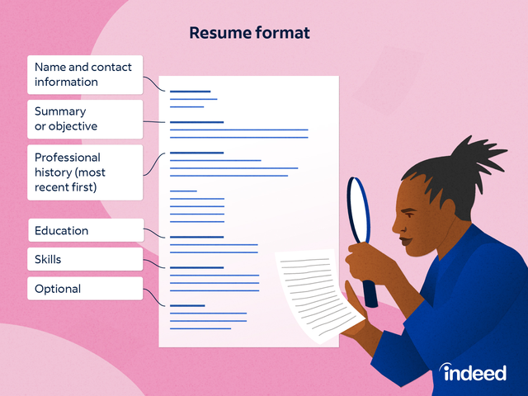

CV vs. Resume
CV
Resume
A resumé is a brief summary of skills and skills over one or two pages. It is short with no particular format rule and highly customizable. The goal of a resumé is to make an individual stand out from the competition. A resumé does not have to be ordered chronologically; it does not have to cover the wholecareer. The resume contains three simple sections: name and contact,
information, education, and work experience.
A CV is more detailed and can be more than two pages. It covers your entire career history. It has a clear chronological order listing the whole career of the individual.

Slide 8

Guidelines for Writing Effective CV
Include your contact details at the top.
Decide whether you want to start with a personal statement or career objective.
Include sections on Key Skills, Knowledge and Achievements, Work Experience, and Education.
When discussing achievements, focus on what you have actually done and the end result achieved.
Include everything relevant in the ‘Work Experience’ and ‘Education’ sections.
Make sure that your spelling and grammar are all correct.
Work on your presentation.

Slide 9
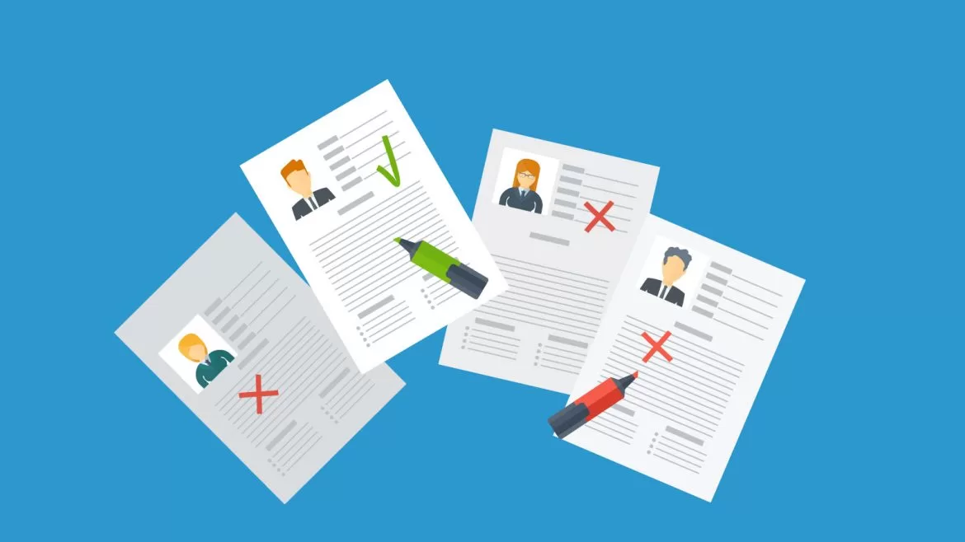
CV Mistakes and Pitfalls to Avoid
Do not be tempted to lie just to ‘look good’.
Avoid leaving gaps in your career history.
Do not start your CV with the dull bits.
Do not include your hobbies and interests.
Don't make your CV too long.
Do not use an unprofessional email address

Slide 10
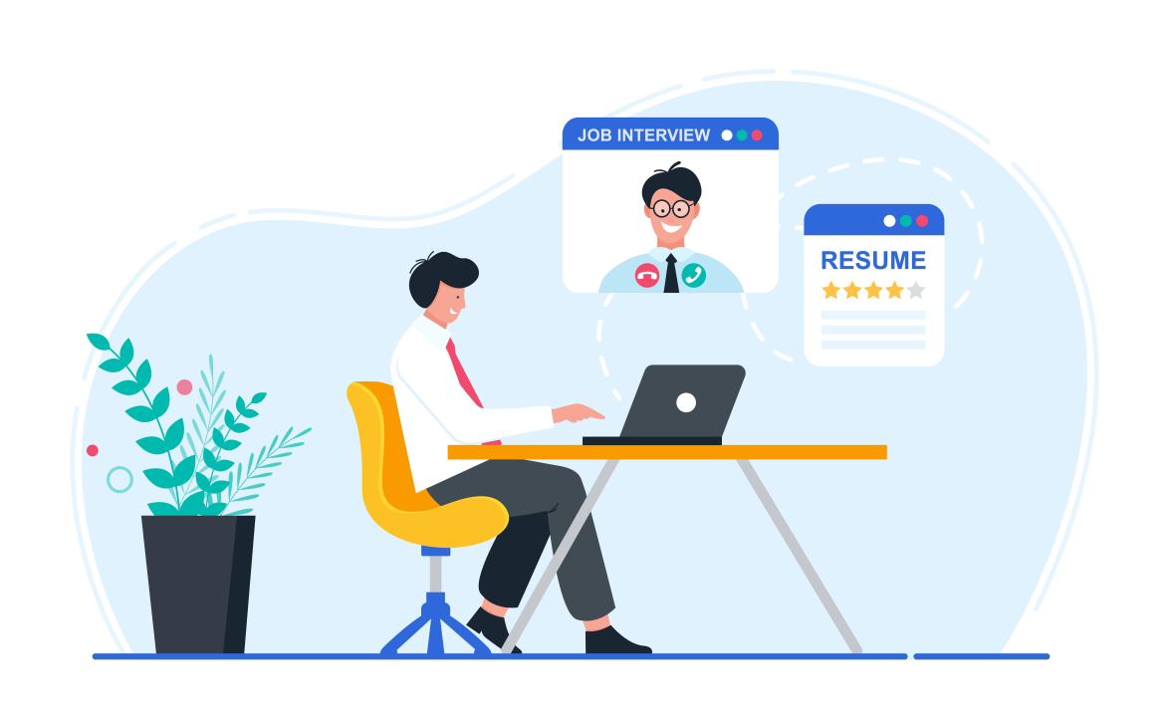
What is online interviews?
An online interview is a job interview conducted through digital platforms, rather than in person. It allows employers and candidates to communicate remotely using video conferencing tools, chat, or even pre-recorded video submissions.

Slide 11
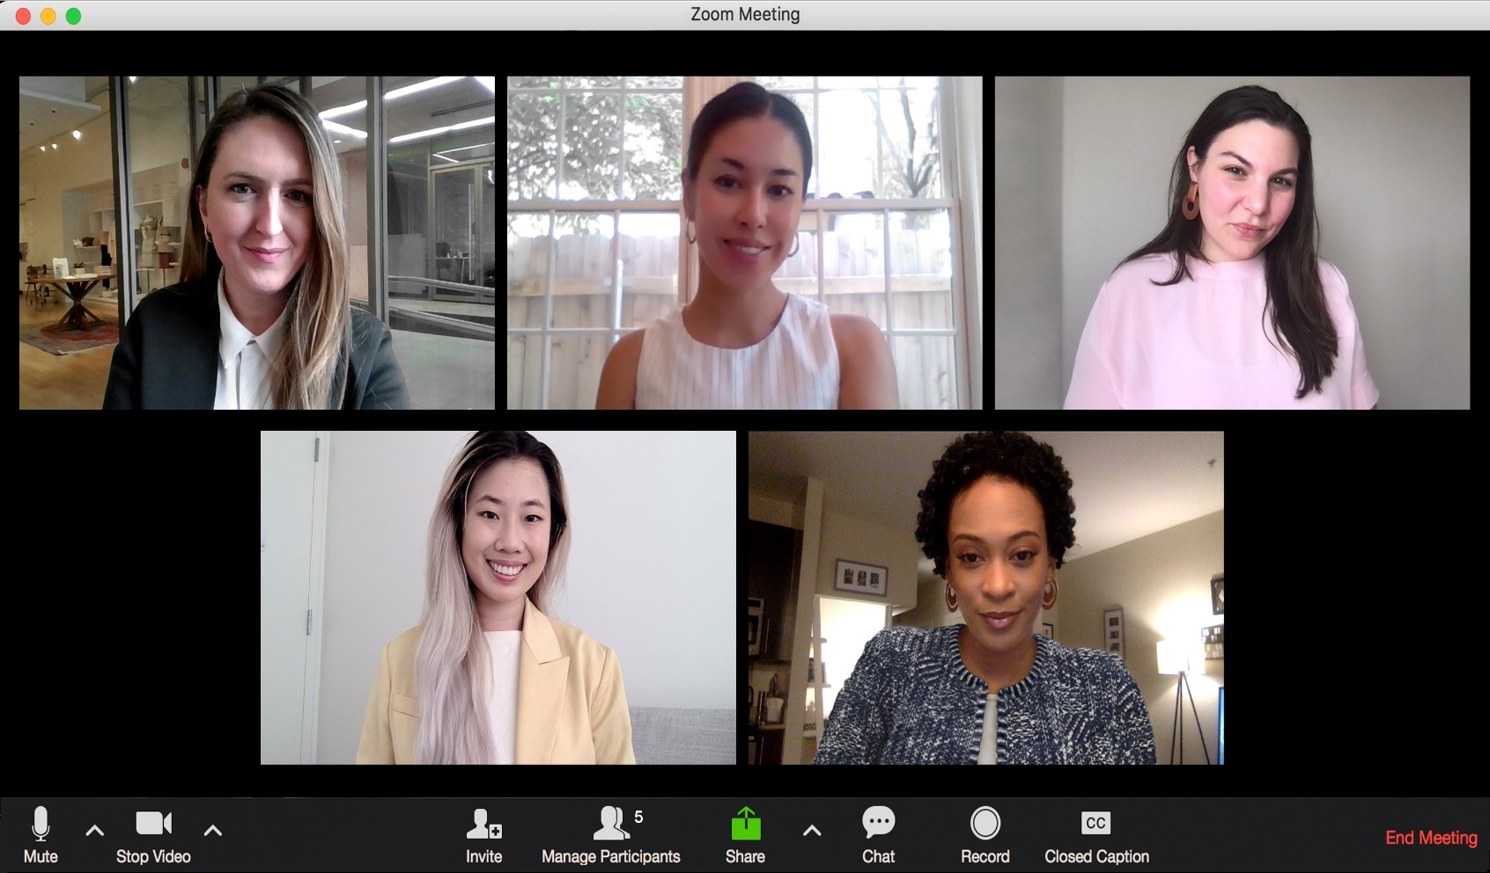
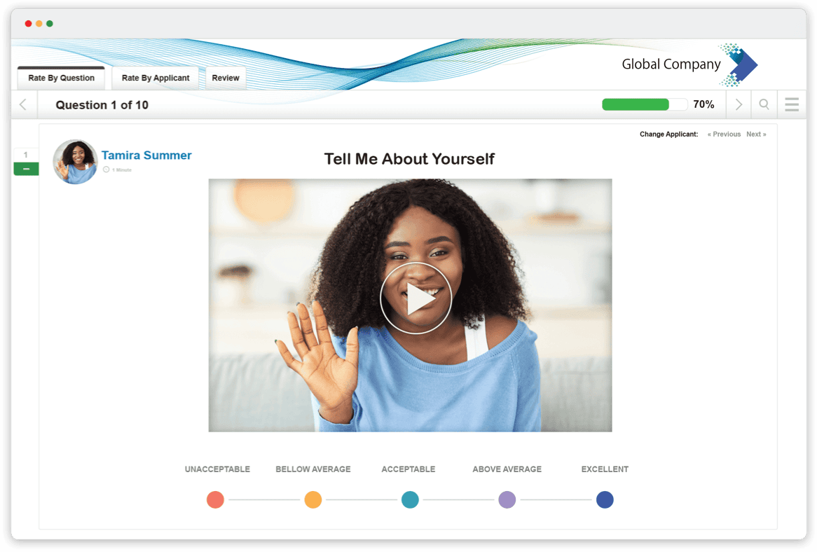
Pre-Recorded Video Interviews:
Video Interviews (Live)
This is the most common type, where the interviewer and the candidate meet via video call on platforms like Zoom, Microsoft Teams, Skype, or Google Meet. The conversation is live, similar to an in-person interview, but the participants are in different locations.
In this format, candidates are asked to record their responses to a set of predetermined questions within a given time frame. These recorded responses are then reviewed by the employer. This is often used in initial screening processes.

Slide 12
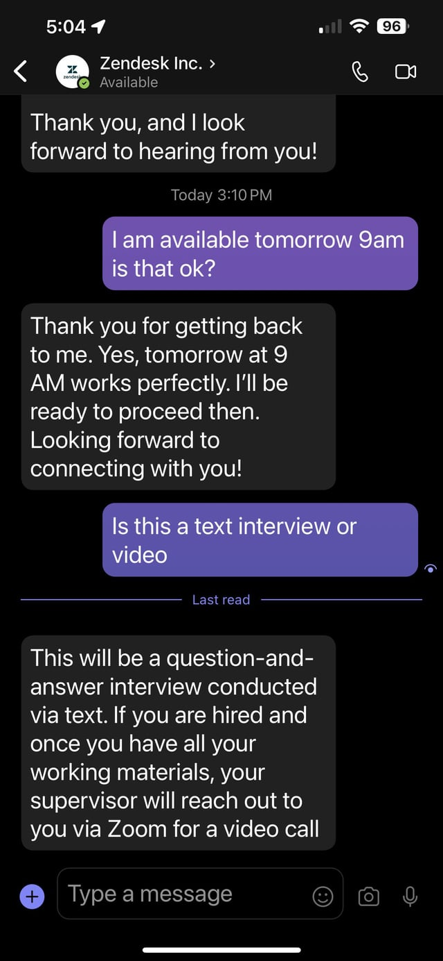
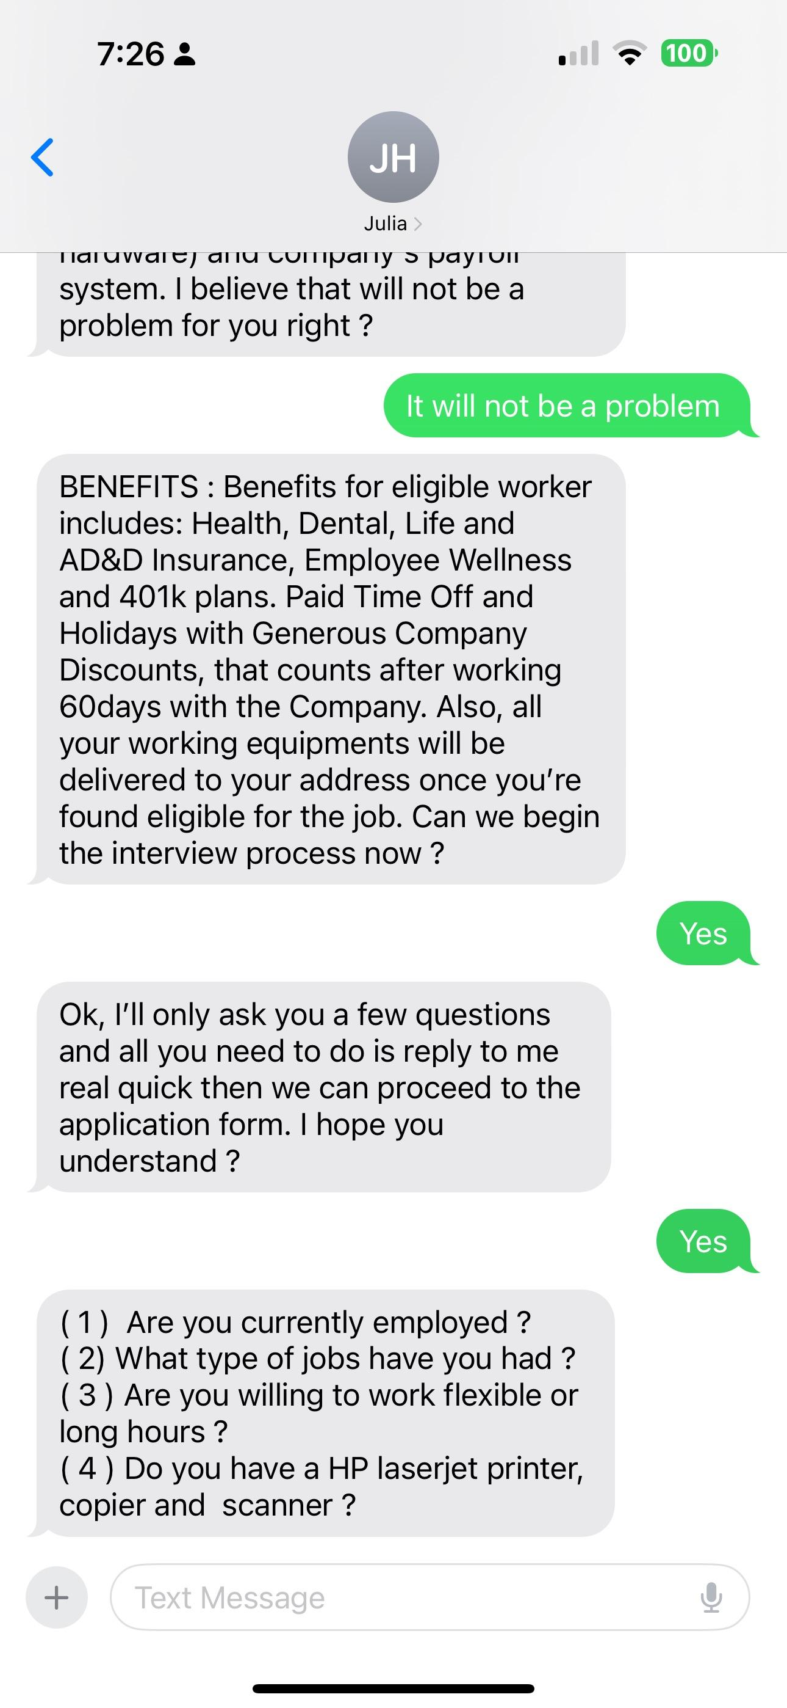
Chat or Text-Based Interviews:
In this format, candidates are asked to record their responses to a set of predetermined questions within a given time frame. These recorded responses are then reviewed by the employer. This is often used in initial screening processes.

Slide 13
Advantages
Challenges
Convenience: Candidates and interviewers can meet without geographical limitations. It also saves time and money on travel.
Flexibility: Scheduling tends to be easier, and candidates may have the chance to interview from their own environment.
Comfort: Candidates might feel more at ease interviewing from their own space, which can help them perform better.
Technical issues: Internet connections, microphone, or camera problems can disrupt the flow of the interview.
Limited personal connection: The lack of face-to-face interaction can make it harder to establish rapport.
Distractions: Being in a home or non-office setting might introduce distractions for both the candidate and interviewer.

Slide 14
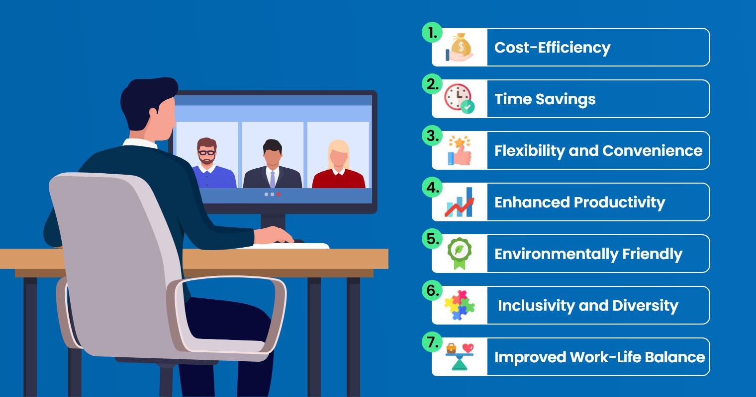
Physical & Virtual
Etiquette

Slide 15
7 Virtual etiquette
Know your surroundings
Dress appropriately
Listen carefully
Unmute your microphone when you wish to talk.
Speak clearly
No food, please
Remain seated and stay present

Slide 16
8 Physical etiquette
Reach the destination on time
Socialize if you have that extra time
When someone introduces you, you must stand up
Give importance to both verbal and non-verbal communications
Try to be as concise as is possible
Be prepared
Keep your phone away
Ask questions when the time is right

Slide 17


Thank You For Your Cooperation

